Slide 1
Proxy Tracing:
Unbiased Reciprocal Estimation for Optimized Sampling in BDPT
Fujia Su*, Bingxuan Li*, Qingyang Yin, Yanchen Zhang, Sheng Li†
Peking University
Presenter: Bingxuan Li

Slide 2
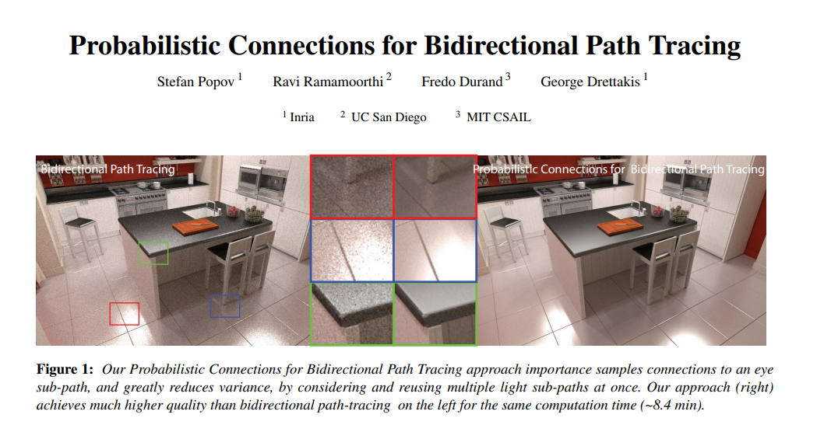
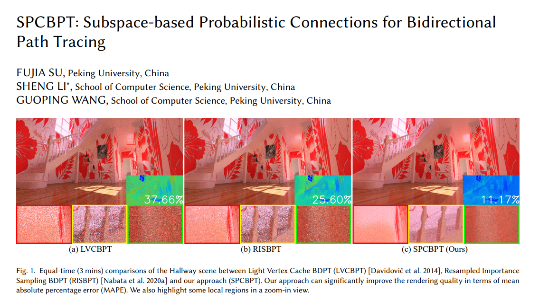
Introduction
BDPT Veach et al. 1995
PCPT Popov et al. 2015
RISBPT Nabata et al. 2020
SPCBPT Su et al. 2022
2

Slide 3
Introduction
BDPT :connect the light path and eye path to create robust estimation
3

Slide 4
Introduction
PCPT :construct light path cache to accelerate sample and use resample to reduce variance
4

Slide 5
Introduction
RMIS :compress light path essential information to vertices, optimize the memory usage and sampling
5

Slide 6
Introduction
First light vertices layer
First light vertices layer
SPCBPT :group similar light vertices to subspace as tree, further optimize sample and connection
6

Slide 7
Motivation
BDPT is famous of its robustness, but it’s actually not robust enough.
Why?
Problem:
when one end vertex resides on a “specular” surface, it produces bad samples with high probability.
(specular, refractive, highly glossy …)
7

Slide 8
Motivation
Usually, “specular” surfaces can be handled by tracing, not by connection.
$$\overset{→}{n}$$
$$\overset{→}{n}$$
$$\overset{→}{n}$$
Specular
Highly Glossy
Refractive
In a connection sampling, can the connected vertex be in the exact direction? Hard/Impossible
8

Slide 9
Motivation
Even with guiding, it could still be hard to make an effective connection.
$$\overset{→}{n}$$
Tiny solid angle
Vertices that can be connected
Highly Glossy
9

Slide 10
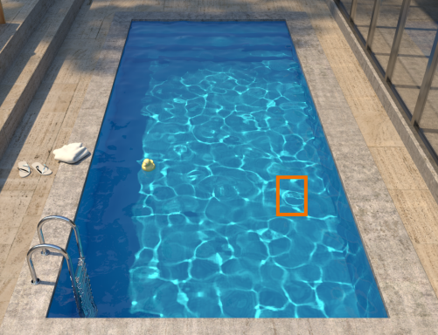
Motivation
This issue is also magnified when facing “caustic” type of paths, as no strategies are effective.
For example, “LSDSE”
LSDS-E
x
LSD-SE
x
LS-DSE
x
L-SDSE
x
-LSDSE
-
Only UPT can handle it, but UPT can be inefficient in many cases.
10

Slide 11
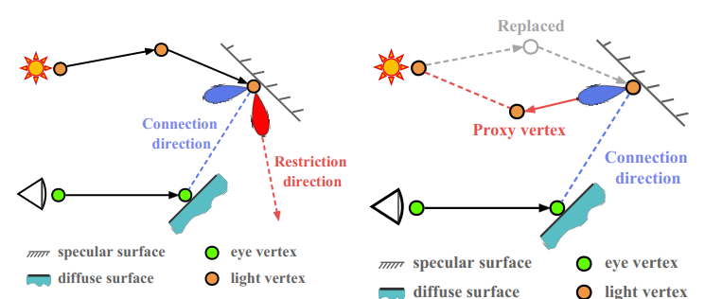
Our method
A bad connection
A fixed connection with proxy vertex
11

Slide 12
Our method
Proxy vertex
highly glossy
12

Slide 13
RECIPROCAL Estimation
Changing the vertices in your sample sounds reasonable …
However, how do you compute the PDF of your final sample?
13

Slide 14
RECIPROCAL Estimation
Original sample x consists of fixed part h, changeable part g
$${\overline{x}}_{0}= \left({\overline{g}}_{0}, \overline{h}\right)$$
14

Slide 15
RECIPROCAL Estimation
$$p\left(\bar{h}\right)= \int_{Ω}{p\left({\bar{g}}_{0}, \bar{h}\right)dμ\left(g_{0}\right)}$$
The PDF of h is computed as
15

Slide 16
RECIPROCAL Estimation
New sample x1 and its PDF
$${\bar{x}}_{1}= \left({\bar{g}}_{1}, \bar{h}\right)$$
$$p\left({\bar{x}}_{1}\right)= p\left(\bar{h}\right)p\left({\bar{g}}_{1} | \bar{h}\right)$$
$= \int_{Ω}{p\left({\bar{g}}_{0}, \bar{h}\right)dμ\left(g_{0}\right)}⋅p\left({\bar{g}}_{1} | \bar{h}\right)$
16

Slide 17
RECIPROCAL Estimation
The final formula will be like
$$I =\frac{f\left(x1\right)}{p\left(x1\right)}=\frac{f\left(x1\right)}{\int_{Ω}{p\left({\bar{g}}_{0}, \bar{h}\right)dμ\left(g_{0}\right)}⋅p\left(\bar{g_{1}} | \bar{h} \right)}$$
17

Slide 18
RECIPROCAL Estimation
When a path can be sampled in infinite ways…
Problem:
Path’s PDF includes integral.
Trivially using MC introduces bias.
Need to estimate an integral’s reciprocal.
single sample
$$\overset{\sim }{I}=f(\overline{x})∗\frac{1}{∫p(\overline{x}|t)dt}$$
Not Bijective
Random Number Space
Path Space
18

Slide 19
Our method
Taylor’s Expansion
$$\frac{1}{∫f\left(x\right)dx}=\frac{1}{B}\frac{1}{1 − \left(1 −\frac{1}{B}\int{f\left(x\right)dx}\right)}$$
Let $g = 1 −\frac{1}{B}\int{f\left(x\right)dx}$, then $\frac{1}{B}\frac{1}{1 − g}=\frac{1}{B}\left(1 + g + g^{2}+ …\right)$
Reciprocal Estimation
(infinite) Integral Polynomial
unbiasedly estimated with Monte Carlo technique
Our Contribution:
Based on past works, an approximately optimal calculation method for the Taylor series is proposed for our scenario.
Use Russian roulette to dynamically decide sampling times, replacing the simple sampling strategies of previous methods.
By analyzing efficiency, we give an approximately optimal bound(the value of B) & the Russian Roulette probability calculation method.
19

Slide 20
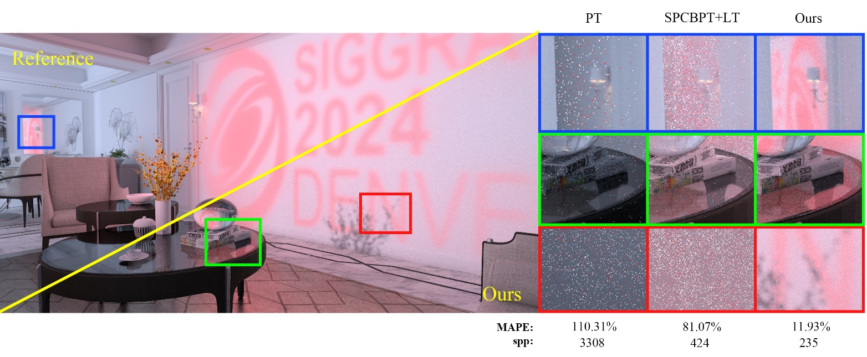
Experiments
A Projector Scene
A projector

Slide 21
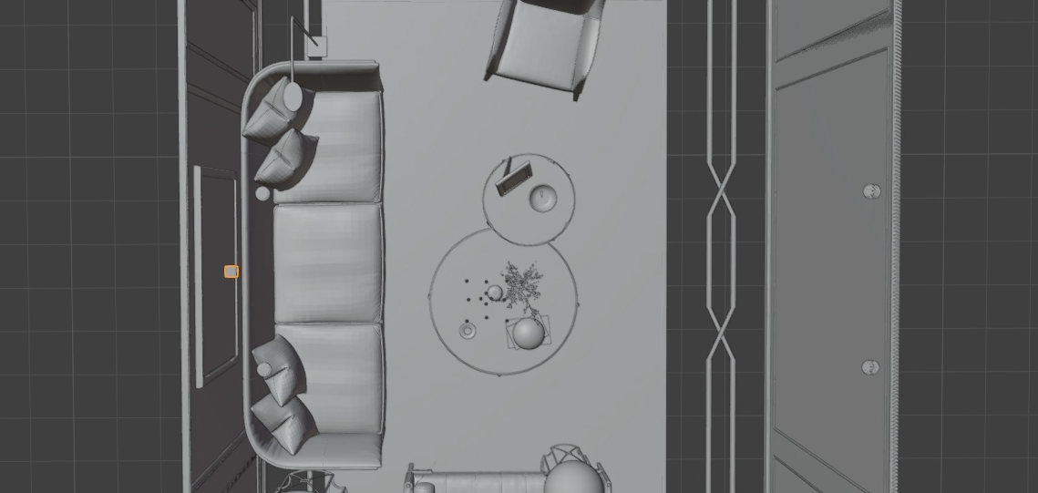
Experiments
A Projector Scene: Scene Analyze

Slide 22
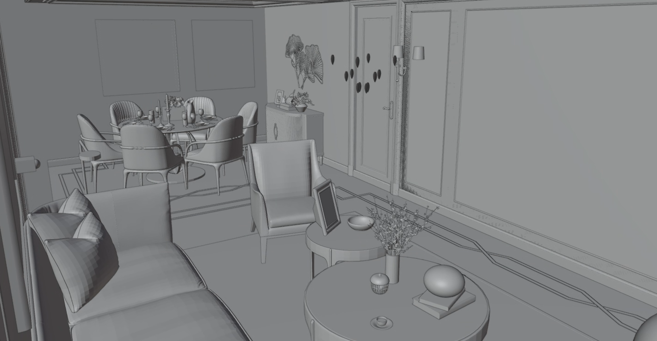
Experiments
A Projector Scene: Scene Analyze

Slide 23
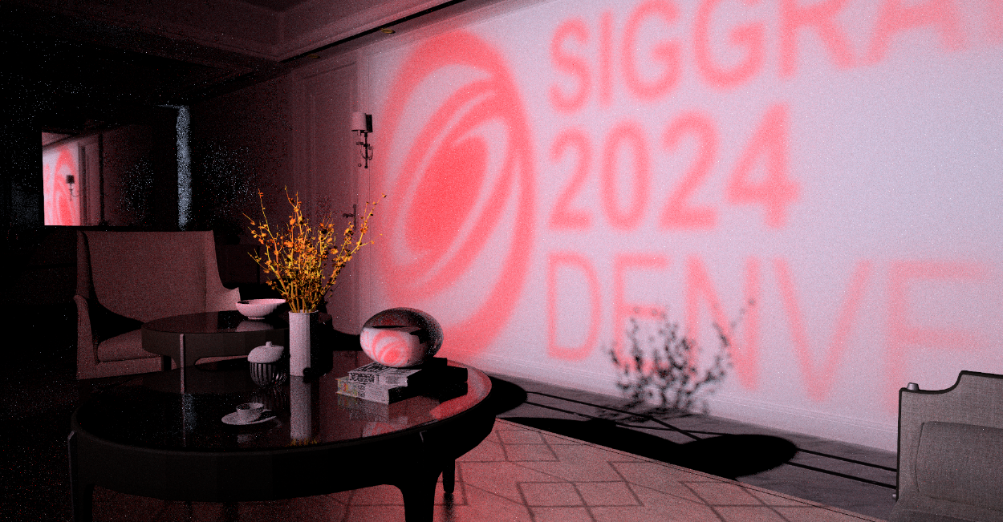
Experiments
A Projector Scene: Scene Analyze
A projector

Slide 24
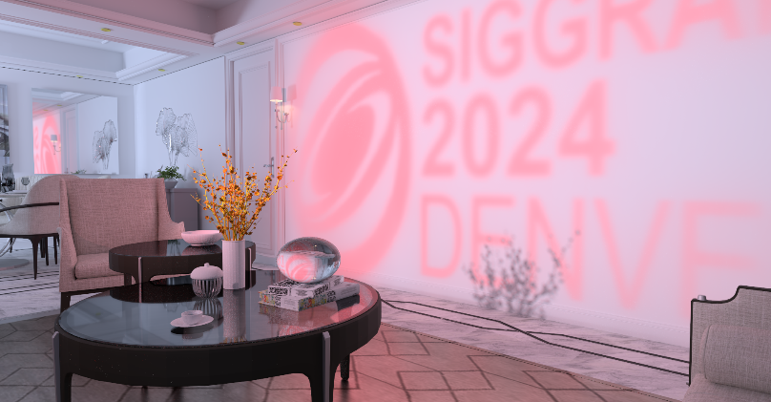
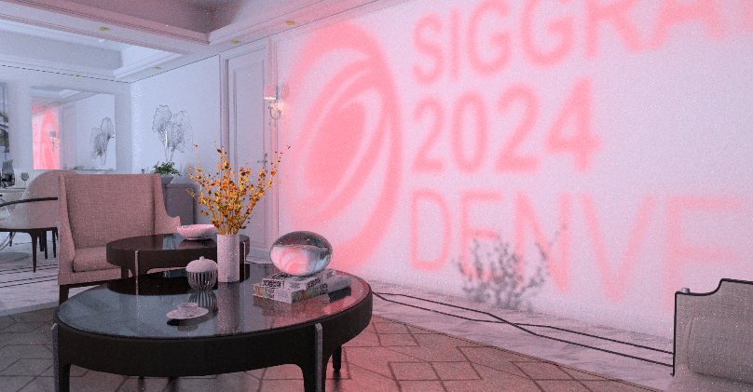
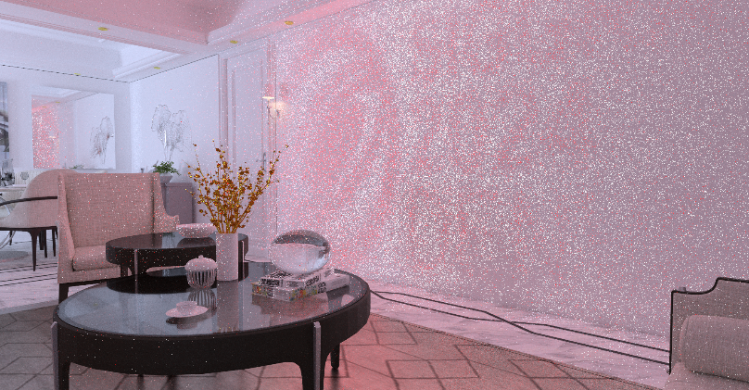
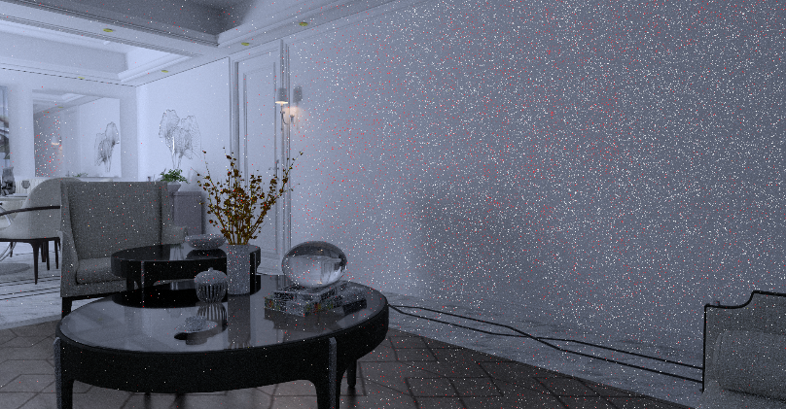
EXPERIMENTS
Reference
Ours
30h
60s
SPCBPT+LT
PT
60s
60s
24

Slide 25
EXPERIMENTS
Path enhanced by our technique
LSSDSE
LSSDE
A projector
LSSDSSE
25

Slide 26
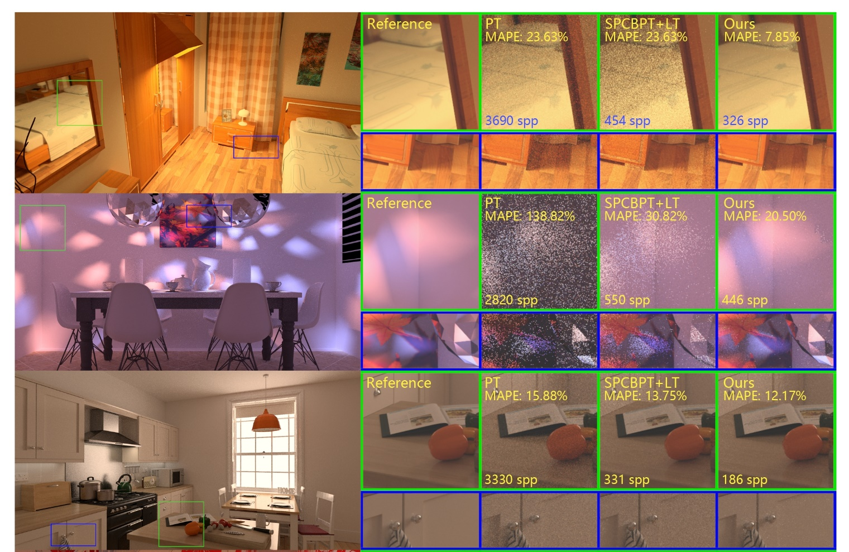
EXPERIMENTS
26

Slide 27
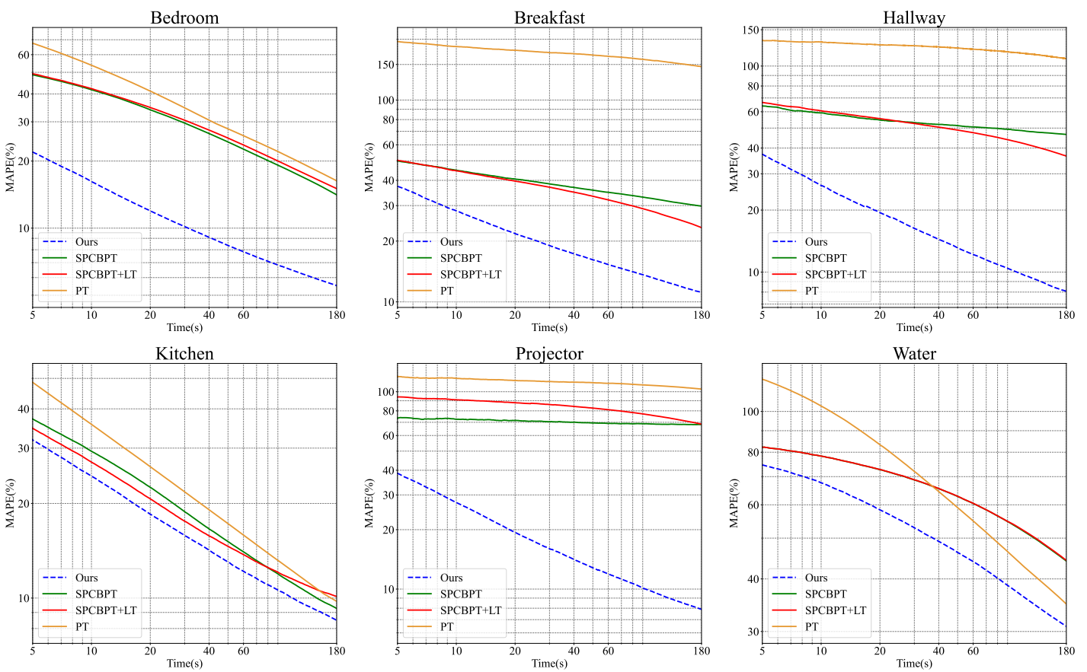
EXPERIMENTS
27

Slide 28
Experiments
A Projector Scene
A projector

Slide 29
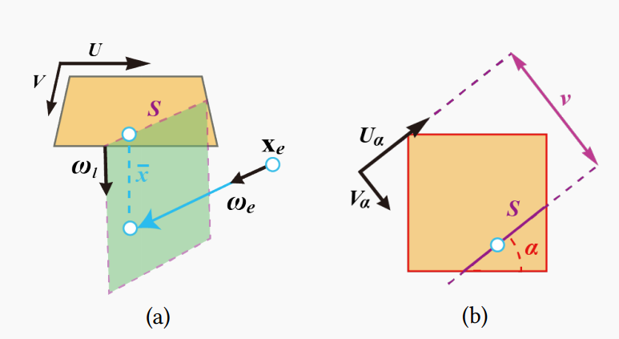
Experiments
Reciprocal Estimator use in photon plane application
Photon Plane is a volumetric rendering application. The contribution of a path is determined by the ray direction and photon planes which are pre-constructed. Summary as sampling a segment in the light source and determining an outgoing direction.
Ideal algorithm CMIS is used to construct the estimator, which involves the reciprocal of integral and uses SMIS as a method to get unbiased result before.

Slide 30
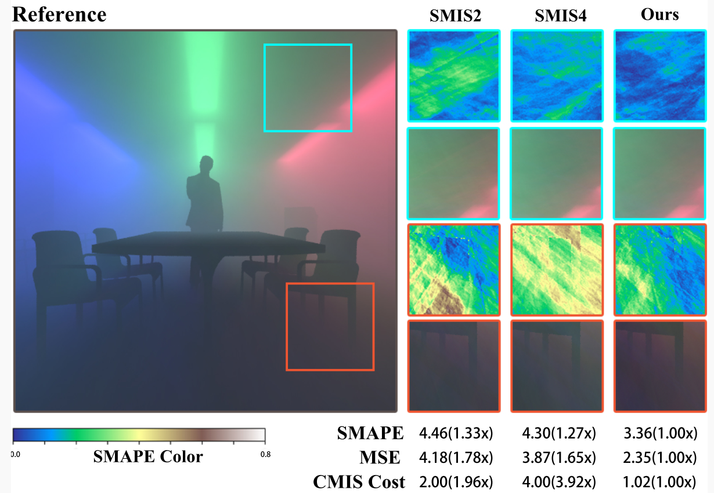
Experiments
Reciprocal Estimator use in photon plane application
More specially CMIS demands the weights of MIS parameter as below
$$\tilde{ω}\left(α, \bar{x}\right)=\frac{p\left(α, \bar{x}\right)}{\int_{T}{p\left(α, x\right)dα}}$$
The previous SMIS algorithm needs to fixed the angle $α$ through all the photon planes to get unbiased result, which leads to bigger variance.
Now use our unbiasedly estimator with Monte Carlo technique. We can directly compute the
reciprocal of integral.
By eliminating the correlation between photon planes and utilizing more optimal sampling, our algorithm achieves better results in terms of computational cost and MSE.

Slide 31
Conclusion
Our Contribution: Proxy Vertex Representation
Expanded Light Vertex Concept: The proxy sampling method redefines light vertices, representing not just single photon paths but the entire space of paths that can reach that photon.
Enhanced Path Space Representation: This broader interpretation allows for more robust and efficient path connections in complex lighting scenarios, improving the effectiveness of BDPT-based algorithms.
31

Slide 32
Conclusion
“Single Direction”
Impossible for connection
A Mirror
32

Slide 33
Conclusion
“Area”
Possible for connection
Using the proxy tracing method, the sampling path space represented by each light vertex has now transformed from a difficult-to-connect linear space set into a regional space set, making the connection of complex caustic light paths possible.
33

Slide 34
Conclusion
$$x_{1}$$
$$x_{2}$$
$$x_{3}$$
$$x_{4}$$
34

Slide 35
Conclusion
$$x_{1}$$
$$x_{3}$$
$$x_{4}$$
$$\overline{x}= x1x3x4\int_{A}^{ }{x2 dμ(x2)}$$
$$A$$
Surface Space
35

Slide 36
Conclusion
$$x_{1}$$
$$x_{2}′$$
$$x_{3}$$
$$x_{4}$$
$$A$$
$$\overline{x}= x1x2′x3x4$$
$$x_{2}′$$
is importance sampled to represent the whole space
36

Slide 37
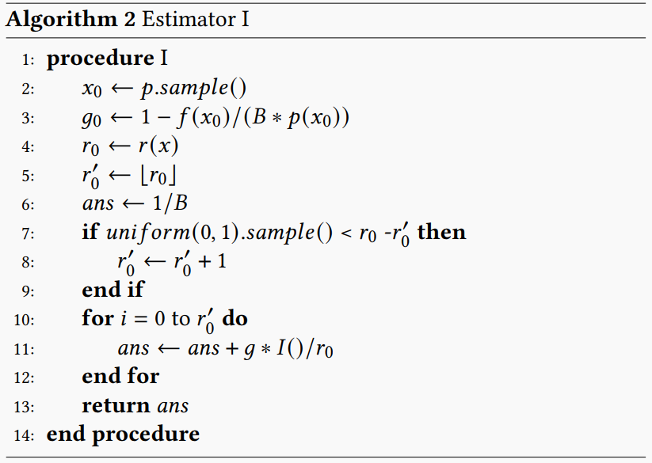
Conclusion
Our Contribution: New Reciprocal Estimation Technique
We developed a new, efficient estimator for computing the reciprocal of integrals.
Efficient Sampling: It utilizes Taylor series expansion for sampling and calculation, making the process more efficient.
Dynamic Russian Roulette: The Russian Roulette method is improved by using dynamic probabilities to balance accuracy and time cost.
Optimal Parameter Bound: We provide an approximately optimal bound (the value of B) and theoretical proofs for the optimality of these parameters within our algorithm, including the Russian Roulette probability calculation.
37

Slide 38
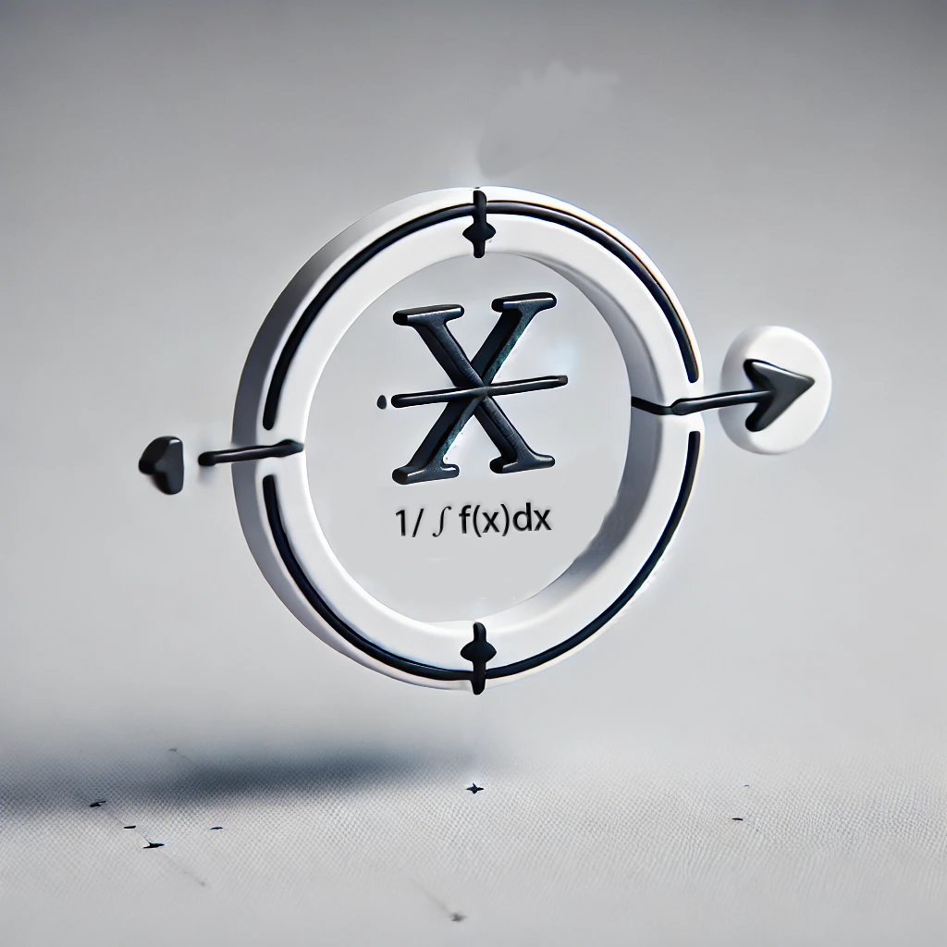
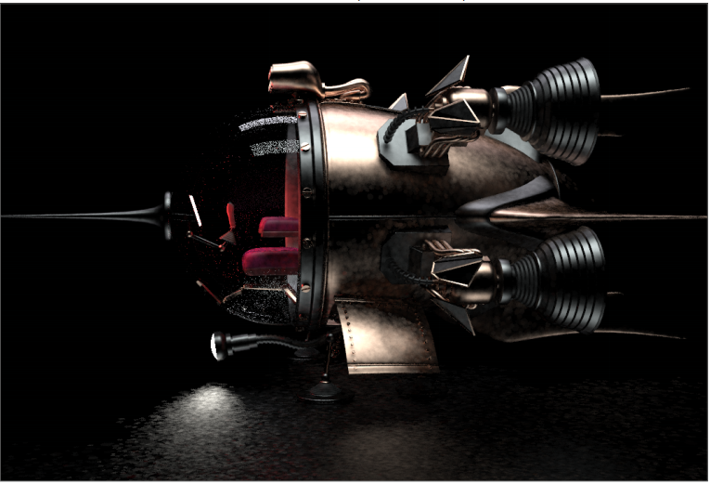
Conclusion
$There$ many situation we could apply our new reciprocal estimation technique
Proxy tracing
$$\frac{f\left(x1\right)}{\int_{Ω}{p\left({\bar{g}}_{0}, \bar{h}\right)dμ\left(g_{0}\right)}⋅p\left(\bar{g_{1}} | \bar{h} \right)}$$
Photon Plane
$$\frac{p\left(α, \bar{x}\right)}{\int_{T}{p\left(α, x\right)dα}}$$
Path Reuse
Our estimator
$$\frac{p\left(t, \bar{x}\right)}{\int_{T}{p\left(t, x\right)dt}}$$
… Other situation
38

Slide 39
THANK You!
39

